Slide 1
GEHC SDT Weekly Status Report
04/12/17

Slide 2
Open Actions
Action item | Owner | Forum | Expected Closure Date | Actual Closure Date | Owner Comment | Status
Mobility Team or tiger team to be formed to resolve all CLICK mobile issues. | Rohit/Gopi | Jan’ 17 Workout | TBD |  | On monitoring the debug logs: FE(Kim Tae Hyun) is resolved. | In Progress
Performance issues: SDT Booking and Architecture Assessment. | Hita/Andrey/Urmila/Chandra | Jan’ 17 Workout | 28-Feb-2017 |  | Developed a logging tool to view log files in different file formats | In Progress
Ownership on Tickets/Process adherence(Agile Mechanism) | Suvarna/Sathyaraj | Jan’ 17 Workout | Ongoing |  |  | In Progress
GEHC to check and confirm on L1 support - on call support | Chandra/CG | Jan’ 17 Workout | TBD |  | No services available in ServiceNow tool. Exploring other opportunities | In Progress

Slide 3
Weekly Snapshot – 04/12/17
Health of the Engagement
Highlights
CLICK : Korea FE(Kim Tae Hyun) mobile sync issues is resolved
Provided SB3 SDT Schedule access for 3 Korea super user and 5 tasks created for Korea region for CLICK R2.3 testing.
Weekly Master data uploaded successfully
SDT team has developed logging tool for viewing Log files, where we have option of search criteria and export to excel and XML.
Creation and review of functional user stories test scripts is completed.
GREEN
Risk / Issues / Challenges
Help Needed
Issues in comprehending data flow due to unavailability of CLICK environment details - Rohit
For troubleshooting the Mobile sync issues to view messages (Request & Response) Click team to provide MT Analyzer tool access to Gopi and Preeti for all the CLICK environment - Chandra
Need clarity on the responses received related to server infrastructure related queries - Chandra

Slide 4
Focus Area Updates
Focus Areas | Owner | Status | Comments
Mobile Sync Issues | CG Team | In Progress | Yet to receive end to end environments details from CLICK team denied due to policy reasons Connected with business user for issues reported in debug log) - Korea FE(Kim Tae Hyun) had a sync issue and its resolved now.
SDT Booking Performance Issues | CG Team | In Progress | Logging mechanism-Logging tool has been created. Code for logging IP addresses, Click request and Response is in progress. Implementing code changes to read SR 'NEW' status from Siebel instead of Click which reduces the number of calls made to CLICK web service. US 180 and US87 are implemented and ready for test.
Release Management | CG Team | Ongoing | Release check list was created and it is updated in our Release readiness check call.
Incident Management | CG Team | Ongoing | Streamlining incidents w.r.t CLICK support cases Problem ticket creation process finalized. Incidents reported in this week are closed.
Support and Development Process streamlining | CG Team | Ongoing | Agile metrics identified and tracked through Rally. Ensuring all email communication to have incident ticket created. Internal defect tracker is maintained to track the QA/UAT defects and owners defined for each defect.

Slide 5
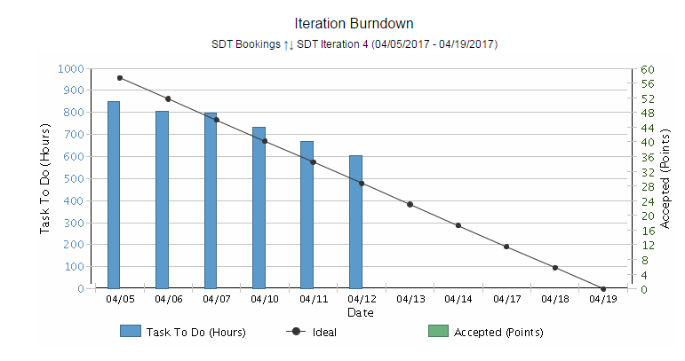
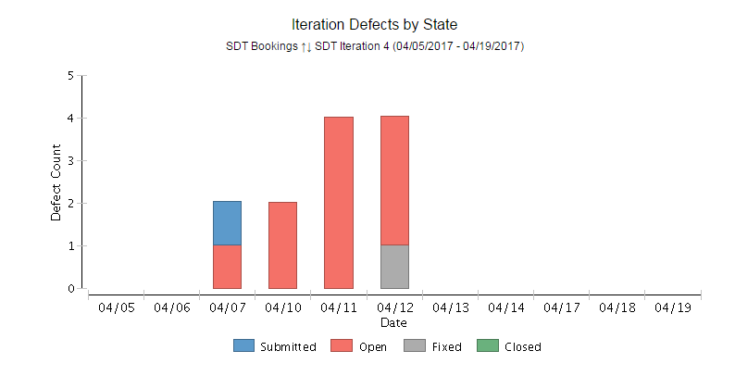
Agile Metrics – SDT Development
Release 2
Iteration 4 Burndown chart
Health of the Egagement
SDT Iteration 3 -(03/21/2017 -03/31/2017) -Completed
SDT Iteration 4 -(04/05/2017 -04/19/2017 –In progress
Release 2 –Iteration 4 highlights
Committed User Stories for Iteration 4 :11
Technical user stories:3
Spike user stories:2
Functional user stories:7
Implementation Done for 2 user stories
Technical(1) and Functional(1)
6 user stories are in progress
2 user stories are in defined state
Deployment is done for 2 completed user stories in CRP.
Testing –In progress for completed user stories
Defects are tracking through rally.
Iteration 4 Defect by State
Risk / Issues / Challenges
Help Needed

Slide 6

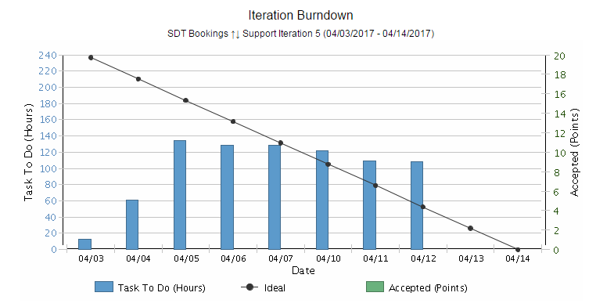
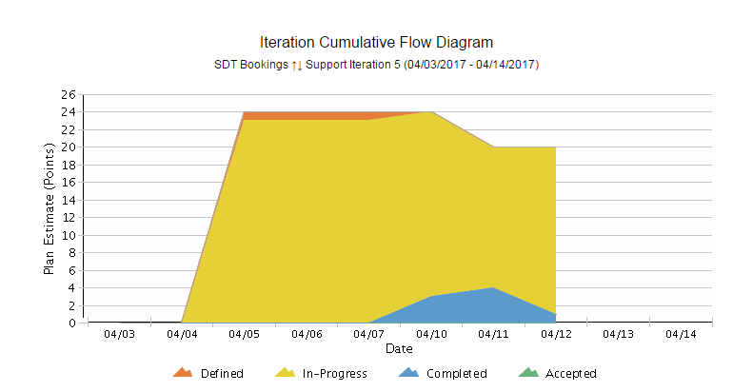
Agile Metrics - Support
Support Iteration 5 (04/03/2017 - 04/14/2017)
Burndown chart
Inferences
Iteration Support Burndown Chart:
Support activities keep on added up on a daily basis based on the support tickets that we receive. Hence there’s a mismatch with ideal.
End of the sprint, all tickets are closed and all the user stories are accepted by Product owner.
Iteration Cumulative Flow Diagram
The tasks related to Release 2.3 and ES LS popup issue, Mobile Sync issues and 1 Incident are in Progress.
1 Incident is completed.
2 incidents are in progress.
Cumulative Flow Diagram

Slide 7
Agile Metrics – SDT Booking Velocity Chart
SDT
Inferences
Velocity Chart
SDT Iteration 1
Velocity of team:50 story points
Accepted By PO: 13 story Points
US85 and US 97 –Accepted by PO as these user stories are already deployed in production as part of release 1.3.1
Iteration length: 10 days(2 weeks)
SDT Iteration 2
Velocity of team: 9 story points
Accepted By PO: 9 story Points
Iteration length: 5 days(1 week)
SDT Iteration 3
Velocity of team: 20 story points
Accepted By PO: 17 story Points
Iteration length: 8 days

Slide 8
Agile Metrics – Support Velocity Chart
Inferences
Support
Velocity Chart
Support Iteration 1
Velocity of team:5 story points
Accepted By PO: 5 story Points
Iteration length: 8 days
Support Iteration 2
Velocity of team:20 story points
Accepted By PO: 19 story Points
Iteration length: 12 days
Support Iteration 3
Velocity of team:20 story points
Accepted By PO: 20 story Points
Iteration length: 11 days
Support Iteration 4
Velocity of team:17 story points
Accepted By PO: 17 story Points
Iteration length: 11 days

Slide 9
Agile Metrics – Resource Utilization
Weekly resource Utilization(5th Apr 2017 – 19th Apr 2017)

Slide 10
Incident Update
Resolved 1 incident ticket
11 Awaiting 3rd party - SDT Schedule / Mobile Issues
9 Awaiting User Info
Inferences

Slide 11
Incident Tickets
Incident Management
Incident # | Module | Key Words | Priority | Status | Location | Queue wait time
INC1735928 | SDT Schedule | Click Issue | 4 - Low | Awaiting 3rd Party | ASPAC-South Korea-Seoul | a month ago
INC1736222 | SDT Schedule | Click Issue | 4 - Low | Awaiting 3rd Party | ASPAC-India-Bangalore | a month ago
INC1738700 | SDT Module | Click Issue | 3 - Moderate | Awaiting 3rd Party | ASPAC-India-Bangalore | a month ago
INC1747182 | SDT Mobile | Click Issue | 3 - Moderate | Awaiting 3rd Party | ASPAC-India-Bangalore | 30 days ago
INC1754593 | SDT Module | Click Issue | 5 - Request for Service | Awaiting 3rd Party | ASPAC-India-Bangalore | 28 days ago
INC1766606 | SDT Module | Mobile Sync Issue | 3 - Moderate | Awaiting 3rd Party | ASPAC-India-Bangalore | 21 days ago
INC1777886 | SDT Module | Click Issue | 3 - Moderate | Awaiting 3rd Party | EMEA-Israel-Haifa | 17 days ago
INC1778499 | SDT Module | Click Issue | 3 - Moderate | Awaiting 3rd Party | ASPAC-Malaysia-Wilayah Persekutuan | 17 days ago
INC1779626 | SDT Module | Click Issue | 3 - Moderate | Awaiting 3rd Party | ASPAC-Malaysia-Wilayah Persekutuan | 16 days ago
INC1793968 | Click | Click Issue | 5 - Request for Service | Awaiting 3rd Party | ASPAC-Malaysia-Wilayah Persekutuan | 11 days ago
INC1464027 | SDT Booking | Click Issue | 1 - Critical | Awaiting User Info | ASPAC-Malaysia-Wilayah Persekutuan | 2 month ago
INC1477114 | SDT Booking | Mobile Sync Issue | 4 - Low | Awaiting User Info | ASPAC-South Korea-Seoul | 1 months ago
INC1480772 | SDT Mobile | Mobile sync Issue | 4 - Low | Awaiting User Info | ASPAC-South Korea-Seoul | 1 months ago
INC1781463 | SDT Module | SDT Booking issue | 4 - Low | Awaiting User Info | ASPAC-South Korea-Seoul | 18 days ago
INC1782655 | Click | Click Issue | 3 - Moderate | Awaiting User Info | ASPAC-Malaysia-Wilayah Persekutuan | 17 days ago
INC1787373 | Click | Click Issue | 3 - Moderate | Awaiting User Info | ASPAC-Malaysia-Wilayah Persekutuan | 16 days ago
INC1787399 | Click | Click Issue | 1 - Critical | Awaiting User Info | ASPAC-Malaysia-Wilayah Persekutuan | 16 days ago
INC1787868 | SDT Module | SDT Booking issue | 3 - Moderate | Awaiting User Info | ASPAC-Malaysia-Wilayah Persekutuan | 15 days ago
INC1816304 | SDT Module | SDT Booking issue | 5 - Request for Service | Awaiting 3rd Party | EMEA-Israel-Haifa | today
INC1825858 | SDT Module | SDT Booking issue | 3 - Moderate | Awaiting User Info | ASPAC-South Korea-Seoul | today
Problem Management
Problem # | Module | Keyword | Status |  |  | Incident #
PRB0045855 | SDT Booking | Google API | Closed |  |  | INC1371682, INC1389372, INC1357120
PRB0045475 | SDT Booking | Performance - Connectivity | Known Error / Pending CA |  |  | INC1310582

Slide 12
THANK YOU

